Slide 1


IoT Based Air Pollution Monitoring System
Group - 8
Abhinaba Pahari(23PH40001)
Arnab Satpati(23PH40010)
Arpon Roy(23PH40011)
Sanjoy Dey(23PH40043)

Slide 2
Objectives
To make an IOT based device that can measure temperature, relative humidity, and the presence of any gases harmful to human health.
To show the real-time data on an LCD and store it for a desired time over a web browser.
Present the air quality via different LED lights and trigger a buzzer if it exceeds the limit of a heritable environment.
The entire system will be portable, low cost, and based on an ESP8266 module.

Slide 3
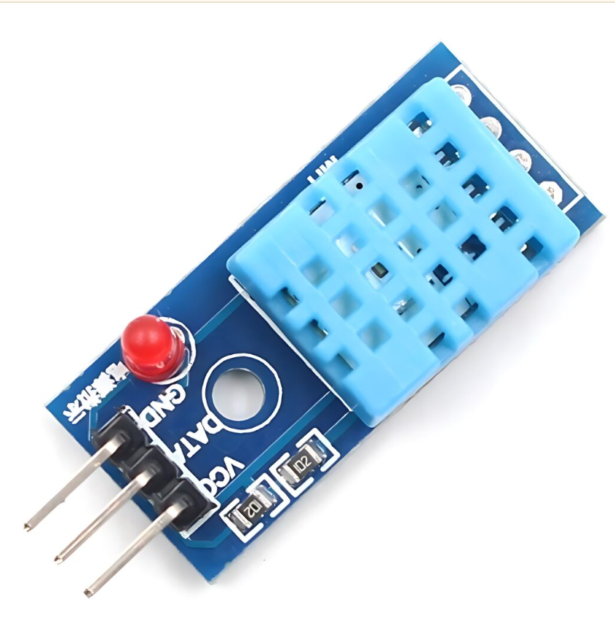
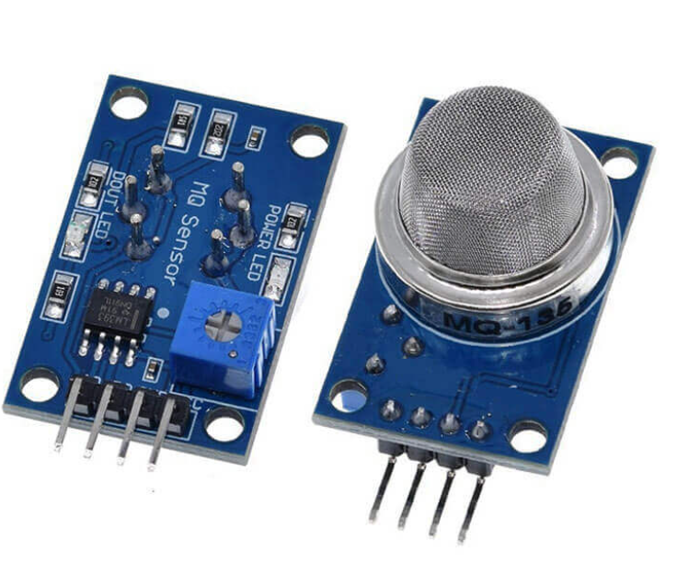
Different Components of the device:
DHT11 sensor
MQ135 gas sensor:
In the presence of any gases, harmful to human health (CO2, NH3, Alcohol, benzene, etc.) the sensor will give different analog outputs as per the gas density.
The DHT11 sensor will be used in the device to measure the relative humidity and temperature.
DHT11 sensor
MQ135 sensor

Slide 4
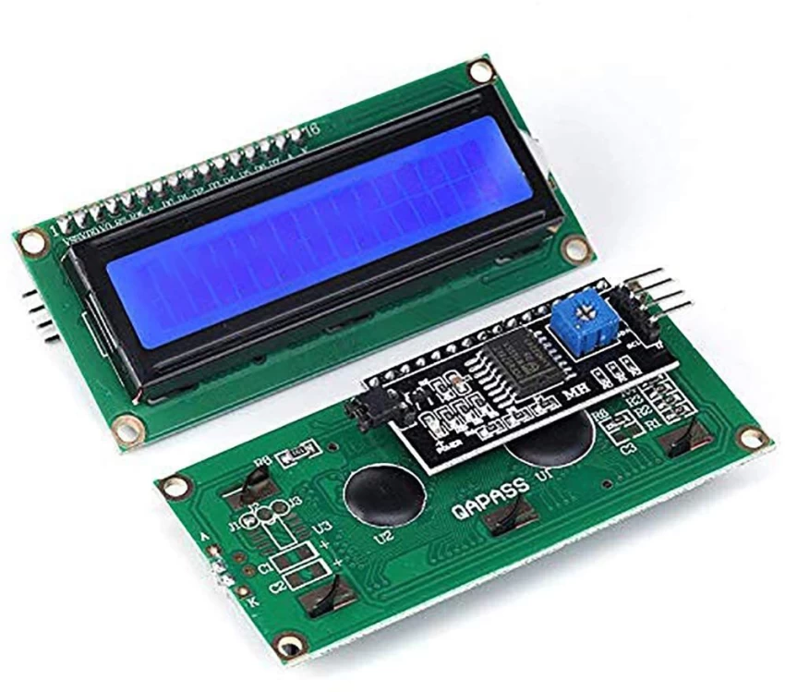
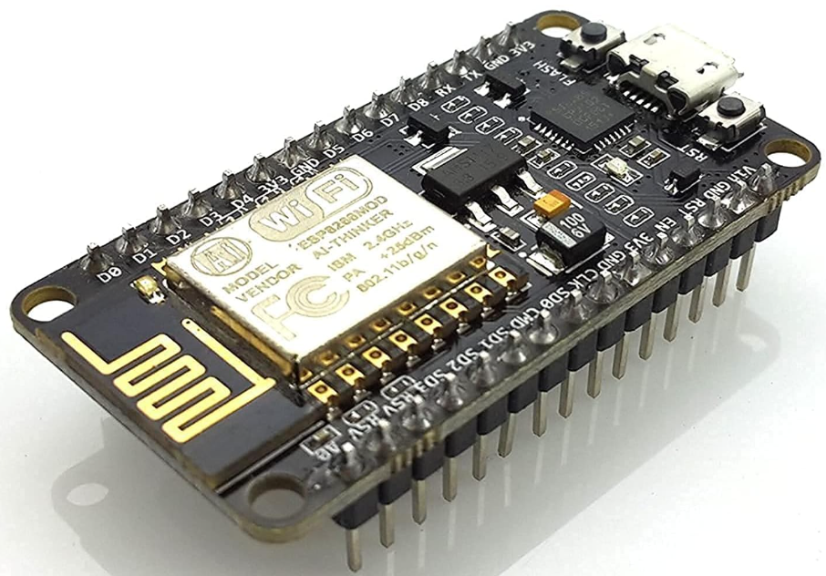
Different Components of the device:
ESP8266 module:
LCD:
This Wi-Fi module will convert the analog output into ppm, temperature, and RH values and store the data over a web server.
The real-time data is shown over a 16*2 LCD screen.
ESP8266 module
LCD screen with I2C module

Slide 5
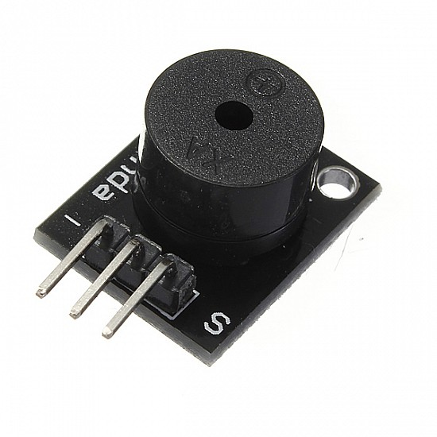
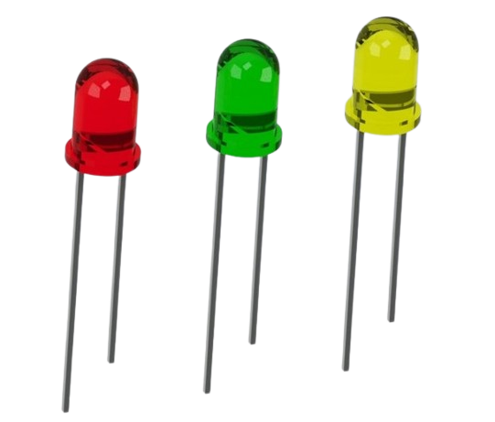

Different Components of the device:
Buzzer
LEDs
Power Source

Slide 6
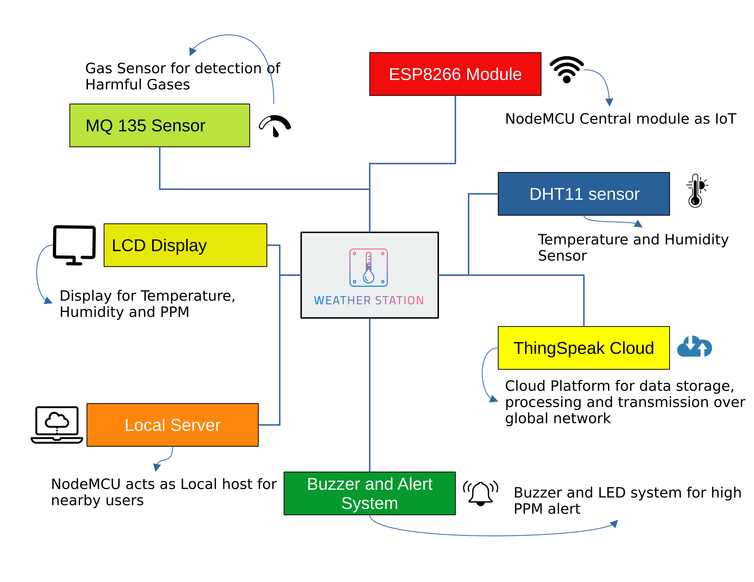
Block Diagram:
Block Diagram of the System

Slide 7
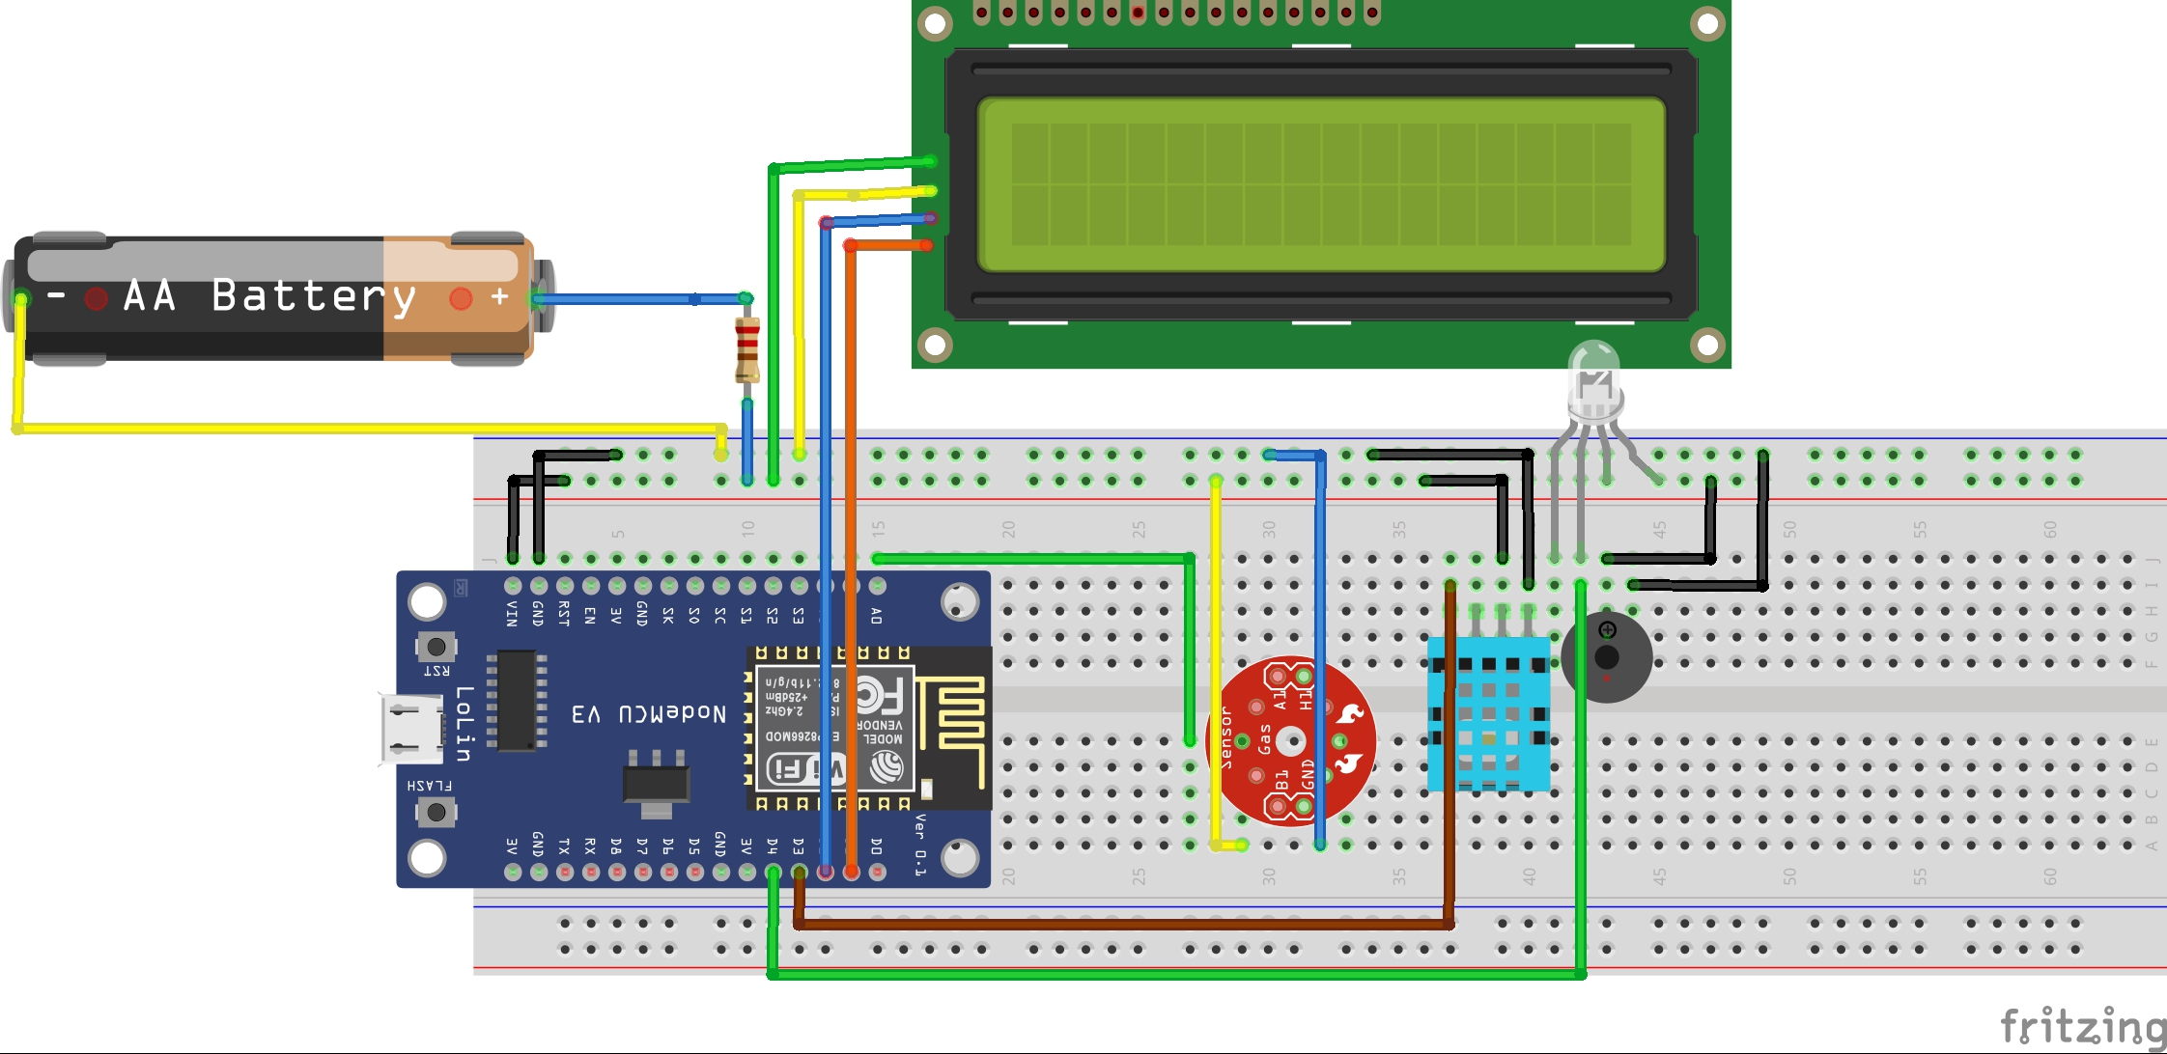
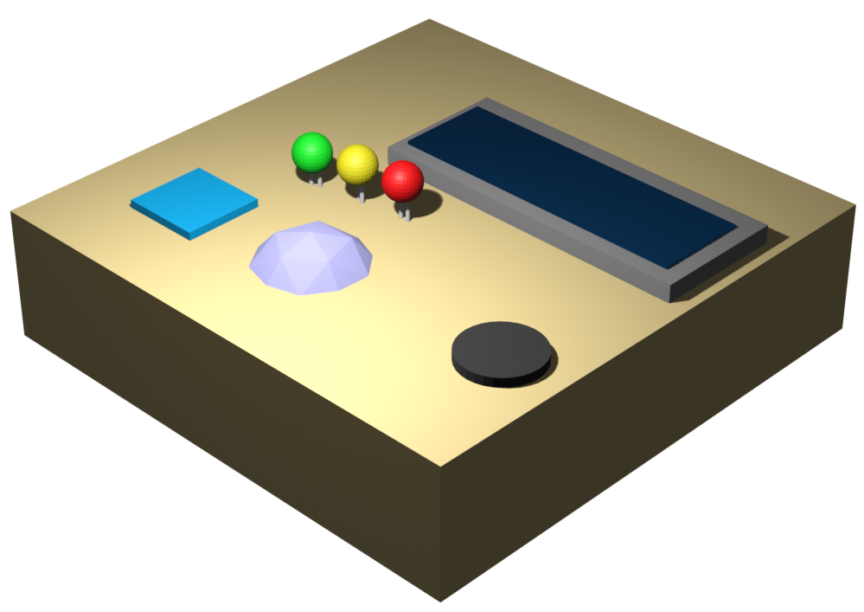
The circuit diagram and 3D schematic of the device:
Power Supply
LCD
ESP8266
LED
MQ135
Buzzer
DHT11
Circuit Diagram of the System
3D Schematic of the System

Slide 8
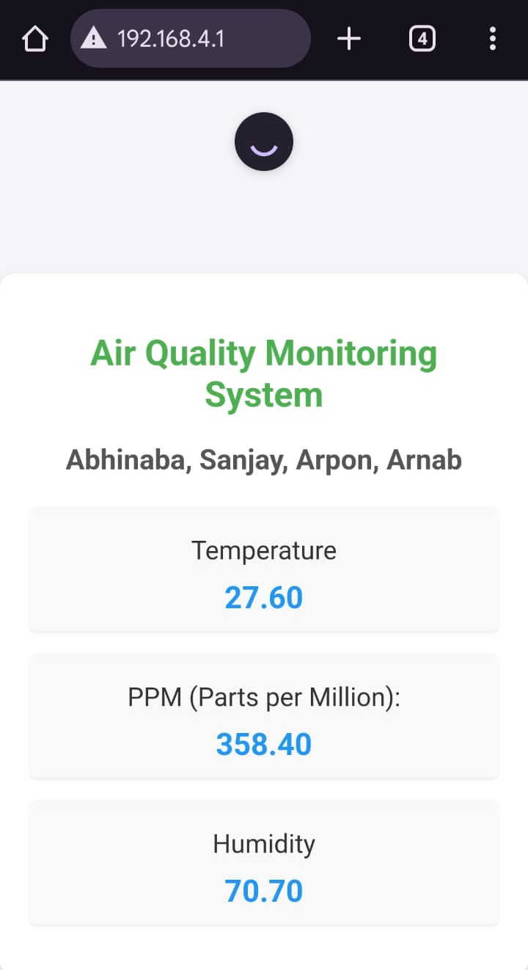
Data over local server:
Server address: 192.168.4.1
Server Name: Air Quality Monitoring
Password: 87654321

Slide 9
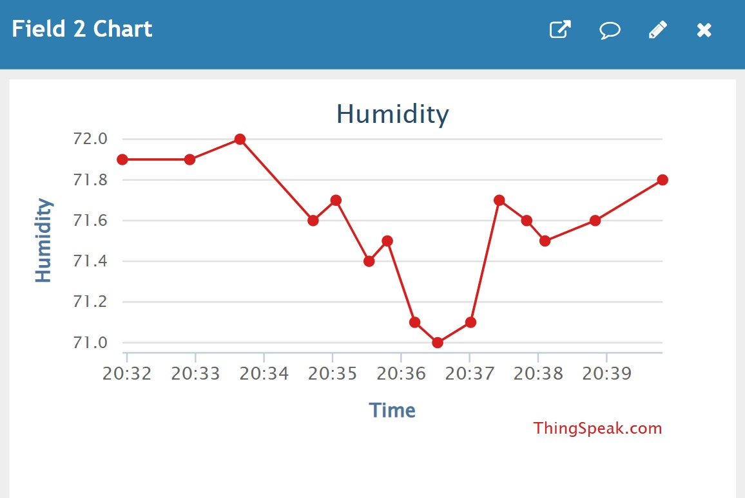
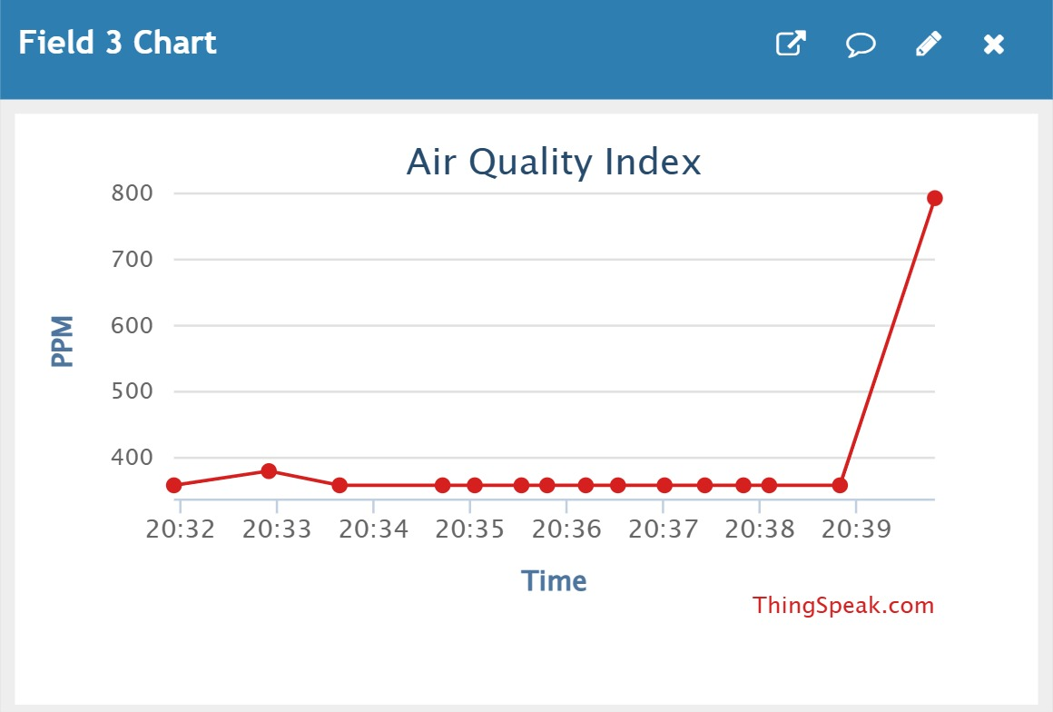
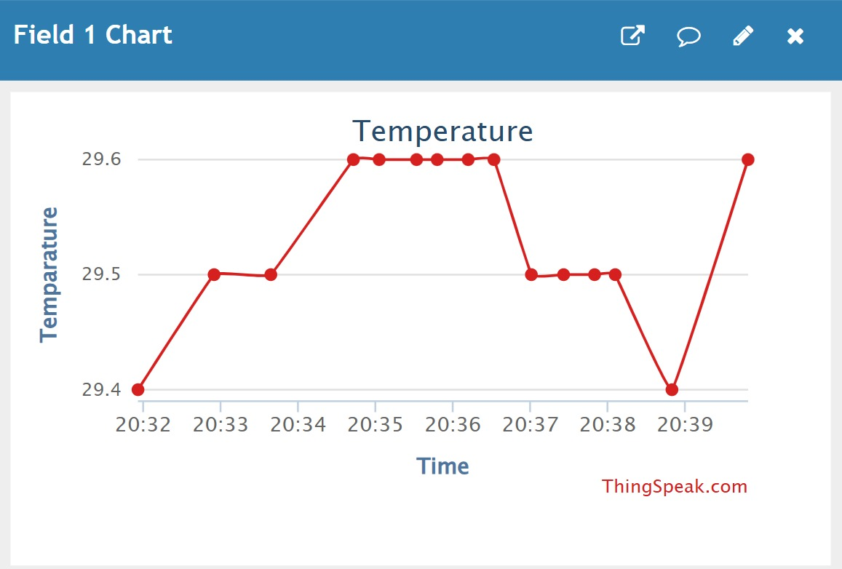
Data over the global web server:
Global server: https://thingspeak.mathworks.com/channels/2729159
Data has been taken on the Thingspeak IoT platform

Slide 10
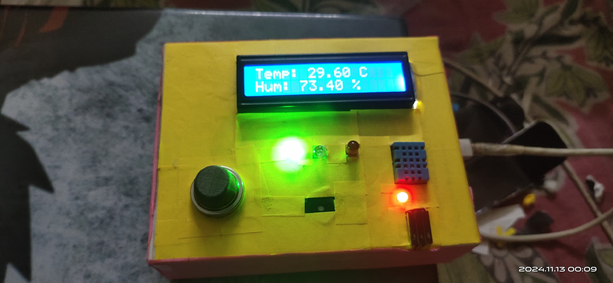
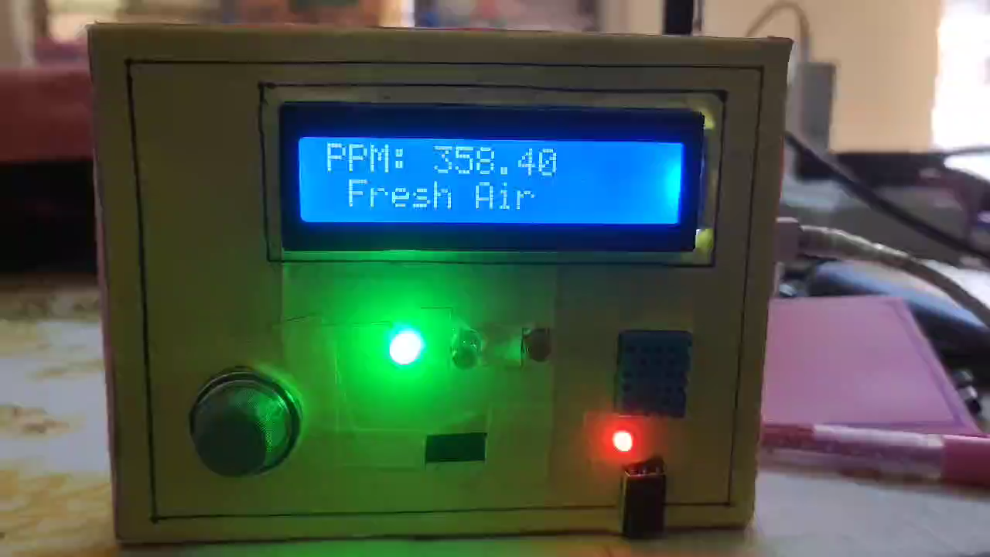
Actual device:
LCD
DHT11
LED
MQ135
buzzer

Slide 11
Future aspects:
The device functionality can be enhanced by adding sensors that detect harmful gases.
Along with the alarm system, an email system can be introduced to send emails if harmful gases exceed the limit.
For compactness and cost efficiency of the device, this can be useful in industrial areas, mines, etc.
IoT-based air quality data can be integrated with health and wellness applications to provide users with personalized health advice. For example, an app could alert a person with asthma to avoid outdoor activities during high pollution periods.

Slide 12
References:
[1] Rani, SHOLA USHA, S. Rajarajeswari, JERRY GEORGE Jaimon, and R. O. S. H. A. N. Ravichandran. "Real-time air quality monitoring system using MQ-135 and thingsboard." Journal of critical reviews 7, no. 18 (2020): 4107-4115.
[2] Srivastava, Deeksha, Awanish Kesarwani, and Shivani Dubey. "Measurement of Temperature and Humidity by using Arduino Tool and DHT11." International Research Journal of Engineering and Technology (IRJET) 5, no. 12 (2018): 876-878. [3] https://gist.github.com/agnunez/179b81659ad807dbee9a
[4] https://docs.arduino.cc/
[5] https://forum.fritzing.org/c/parts-submit/23
[6] https://www.nodemcu.com/index_en.html#fr_5475f7667976d8501100000f

Slide 13
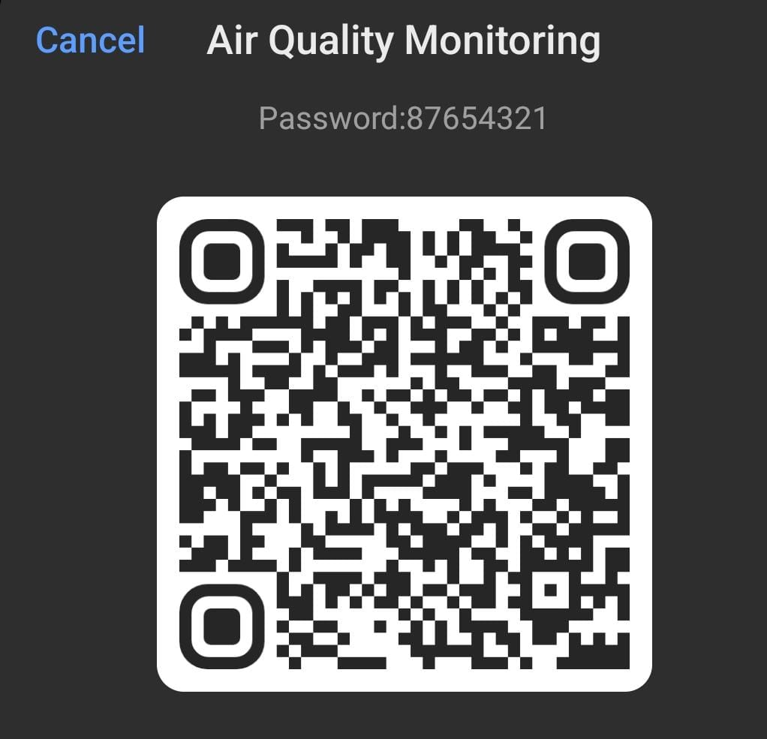


Let’s Scan the QR
Scan it to connect Air Quality Monitoring Wi-Fi network
Scan it to access real-time data on our local web server
Scan it to access real-time data on the Thingspeak web server
Wi-Fi Network: Air Quality Monitoring
Password: 87654321
The IP address of the local server: 192.168.4.1

Slide 14
Thank You

